Slide 1

Online Electronic Payment System Using PREDICT II Protocol
Mid Term Project Presentation
6th September, 2001
By
Nishanth Menon
98m11, S₆ MCA

Slide 2

Contents
Problem statement
Use case view
Database design
General package layout
Test plan
Deployment diagram
Implementation so far
Development platform

Slide 3
Problem Statement
The objective of this project is to create a scalable model of an online electronic payment system, allowing authorized users to access and utilize their wealth from anywhere in the Internet using the PRotocol Enhancement of DIgital Cash Transaction- II protocol.

Slide 4
Problem Statement .Contd..
Inputs.
User Information – name, Pass Phrase etc.
Amount of Cash to be transacted.
The IP of the Zone Server.
The IP and optionally the port of the Server socket of the remote client software.
The Key Generation information (including no: bits RSA Key, Hashing algorithm for the password storage and other configuration information).
Outputs.
Transaction Result–Whether completed or aborted etc.
Passbook format Transaction information.
Complete transaction information.
Personal information of authorized client.

Slide 5
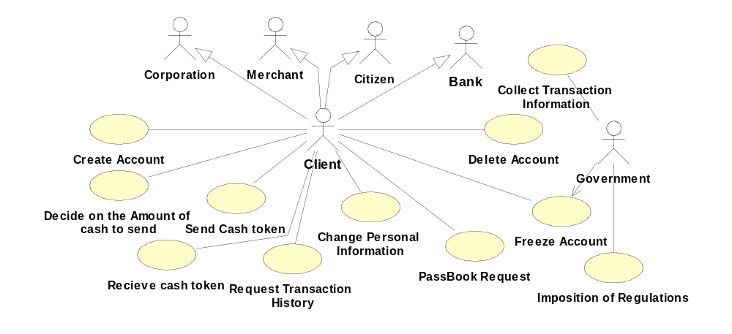
Entire System Use Case Diagram

Slide 6
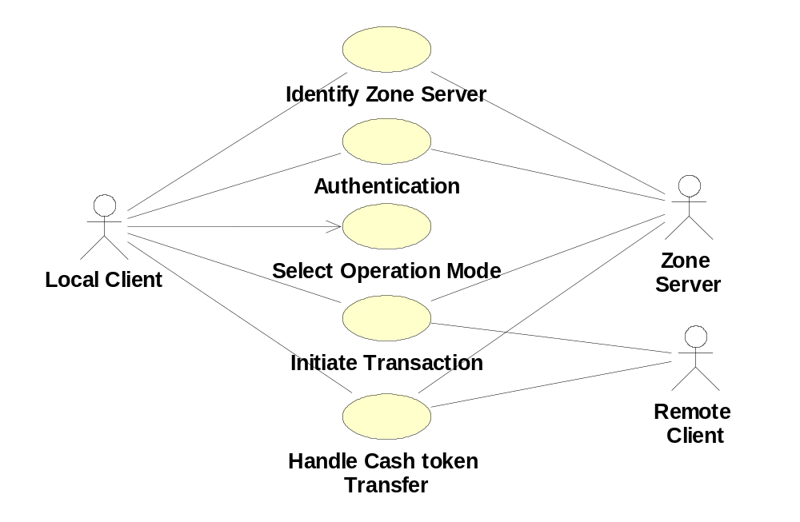
Client Use Case Diagram

Slide 7
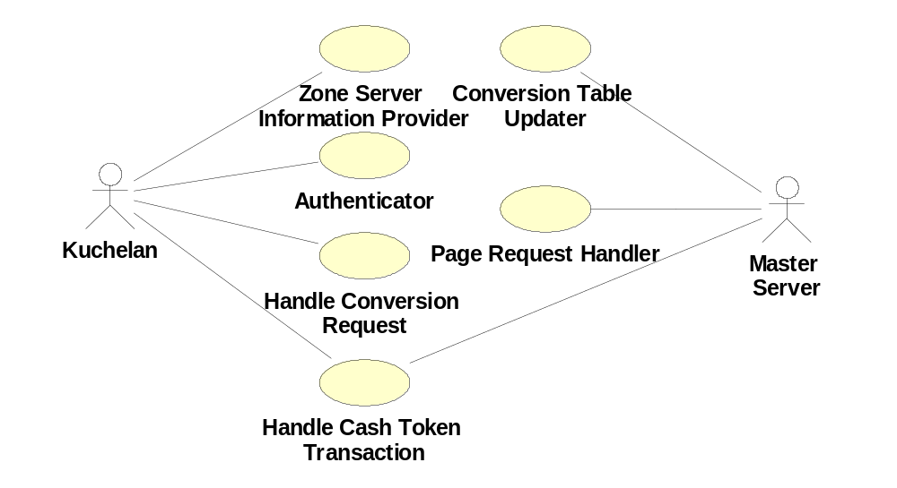
Zone Server Use Case Diagram

Slide 8
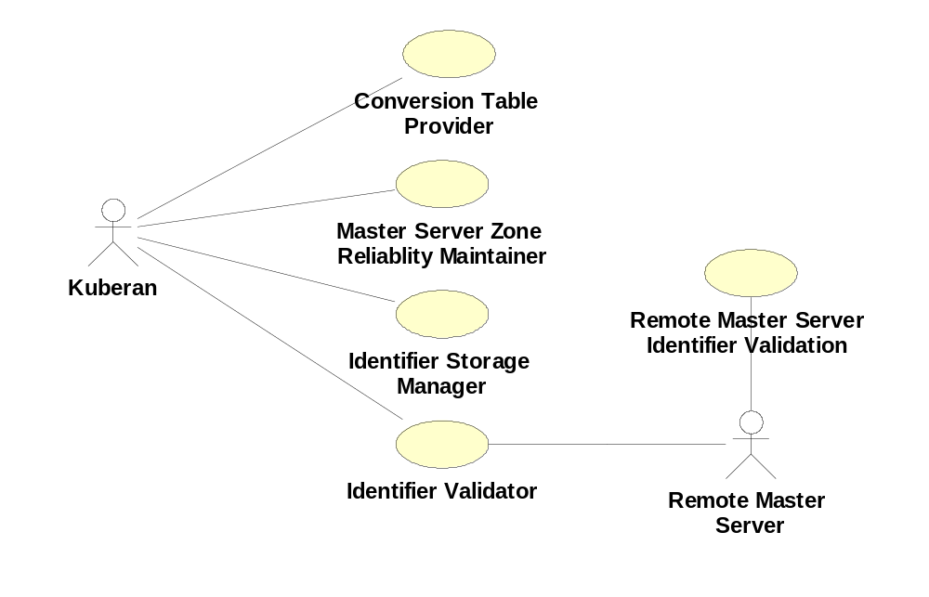
Master Server Use Case

Slide 9

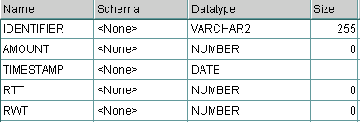

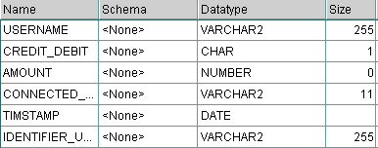
Database Design
PersonalInformation- Kuberan DB
IdentifierInformation- Brahma DB
Password – Kuberan DB
TransactionInformation –Kuberan DB

Slide 10
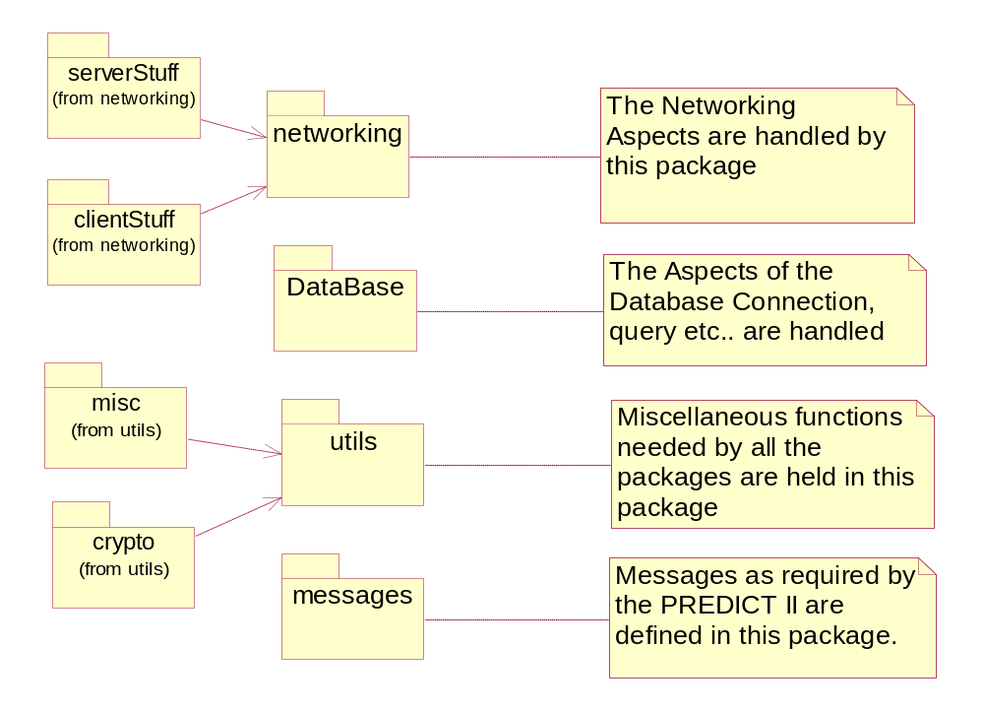
General Package Layout

Slide 11
Test Plan
Main operation (function) in every class - allows for separate testing of each class.
  Functional tests –shows I/P and O/P of each method for given set of values.
  Stress tests & boundary tests.
  Integration tests.

Slide 12
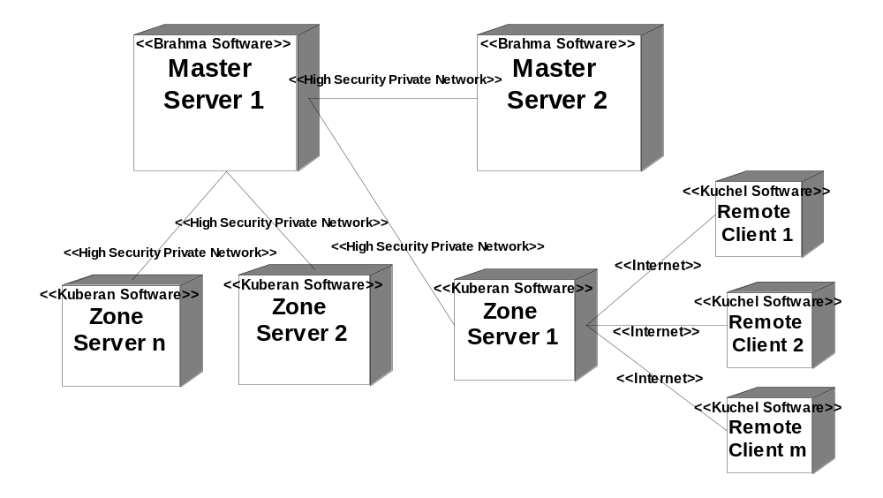
Deployment Diagram

Slide 13
Implementation So Far
Prototypes for the networking and database package have been tested.
Encryption package (crypto) is fully implemented and tested.
HTTPS server setup complete.

Slide 14
Development Platforms
Operating System – RH Linux 7.1 and Windows 2000 (JDK1.3 support)
Language – JDK1.3.1, Perl (Server Side CGI)
Database – Oracle 8i

Slide 15
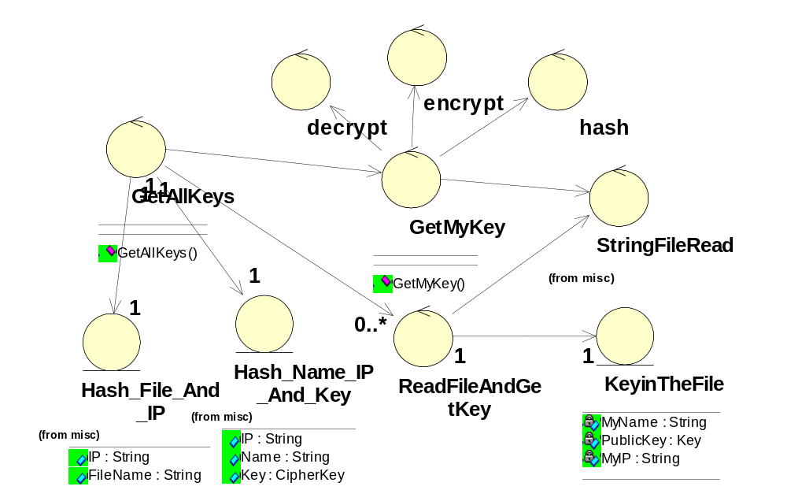
Getting All the Keys

Slide 16
PRotocol Enhancement for DIgital Cash Transaction-II
MASTER
SERVER
7
Reject / Status Check
10
Confirm Acknowledge
Or
Reject Confirm
9
Confirm Request
8
Status Confirm
Zone 1
SERVER
Zone 2
SERVER
1
Cash Transmit
4
Deposit Acknowledge
6
Deposit Confirm
3
Cash Deposit
11
Transact Complete
2
Cash Forward
11
Transact Complete
Sender
Receiver
5
Deposit Acknowledge Forward

Slide 17
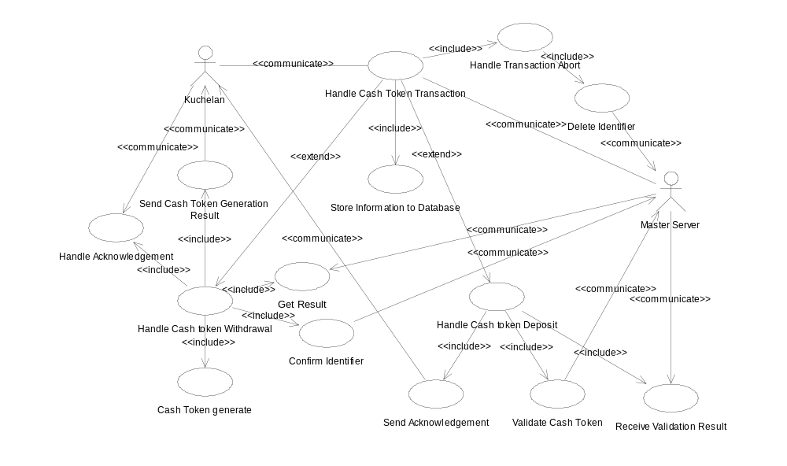
‘Kuberan’ handle Cash token

